Slide 1



Preserving Family Wealth
21 August 2025
FCA No.551744
Claire Calder
The webinar will start in a few minutes, please make sure your microphones are muted and video is switched off.
Notes:
Greg from the AWM Group. Introduce as a Global Wealth Manager

Slide 2

Risk Disclaimer
•This presentation is for information purposes only and does not constitute any financial, legal or accounting advice
•Ascot Wealth Management is authorised and regulated by the Financial Services Authority.
•These investments are not suitable for everyone
•Annual management charges apply
•Tax legislation could change in the future
•The value of tax reliefs will depend on an investor’s personal circumstances
•These investments could fall/rise more than mainstream investments however you could get back considerably less than you invested
Notes:
Presentation notes – 1 minute introduction
Summary of the key themes to be presented during the webinar

Slide 3
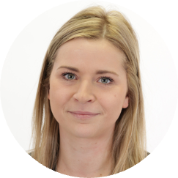
Your host:
BIO: Claire has been a financial adviser for 11 years. Advising a wide range of clients using her experience & expertise to create bespoke solutions.
Claire Calder
Financial Adviser
Notes:
Presentation notes – 1 minute introduction
Summary of the key themes to be presented during the webinar

Slide 4

Introduction
Importance of long-term wealth preservation
Key Risks: taxation, poor succession planning, family disputes
Objectives
Understanding tools: Trusts, Gifts, Business Relief
Tax Efficiency vs. Protection

Slide 5

Landscape
Rising IHT
Life expectancy
Longer retirement
Blended families
Complex needs
Regulatory environment

Slide 6
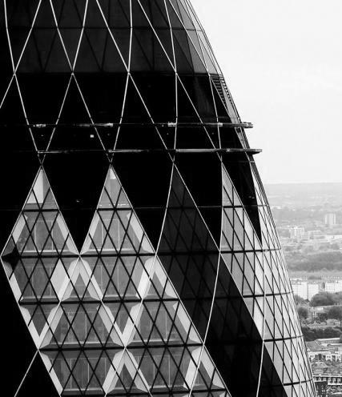
IHT Refresher
Nil Rate Band
£325,000
Residence Nil Rate Band
£175,000
Fixed until 2030
Taper on Estates over £2m
£2.7m on 2nd death loses all RNRB
IHT Rate
40%
No CGT on death (currently)

Slide 7
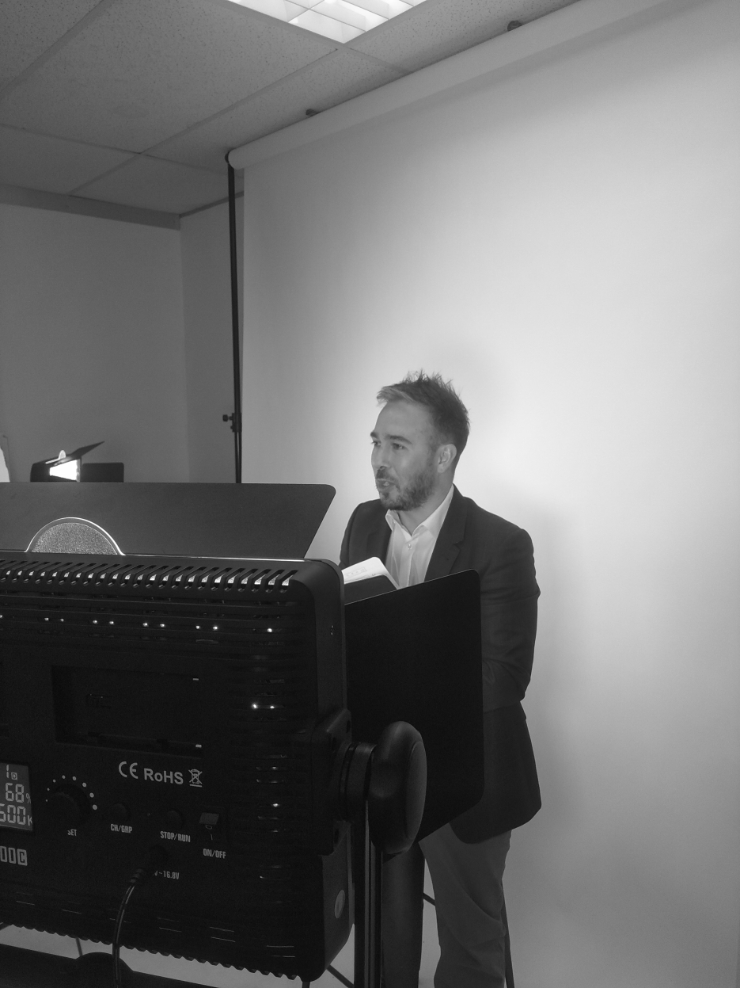

Trusts
• Control over distribution
• Asset protection from divorce, creditors, or mismanagement
• Tax planning opportunities

Slide 8

Types of Trust
Discretionary Trusts
Bare Trusts
Interest in Possession Trusts
Relevant Property Regime: 10 year anniversary charges when no interest in possession exists. Exit charges could exist in certain circumstances.

Slide 9

How can Trusts benefit you?
Gifting to Trust
NRB every 7 years
Retain control in your lifetime as Trustee
Mitigation of IHT when gifts are made
Gifts even if immediately before death can reduce Estate for RNRB (even though still included in Estate for IHT)
After death
IIP to claim spousal exemption and RBRB
Protection of family wealth from divorces and unforeseen situations

Slide 10
Methods of Gifting
Annual exemption (£3,000 per year)
Small gift allowance (£250 per person)
Wedding gifts allowances (£5,000 to a child. £2,500 to a grandchild or great-grandchild. £1,000 to any other person)
Potentially Exempt Transfers (7-year rule)
Regular gifts out of income (underused)
Notes:
Presentation Notes – 3 minutes

Slide 11
Life Assurance
Whole of Life Assurance
Level Term Assurance
Benefits:
Premium and benefit outside scope of IHT
Written into Trust for bloodline

Slide 12

Pensions & IHT
Historically outside estate for IHT
BUT pensions fall inside taxable Estate from April 2027
Value will be used in calculation for eligibility of RNRB
Notes:
Presentation Notes – 5 minutes

Slide 13
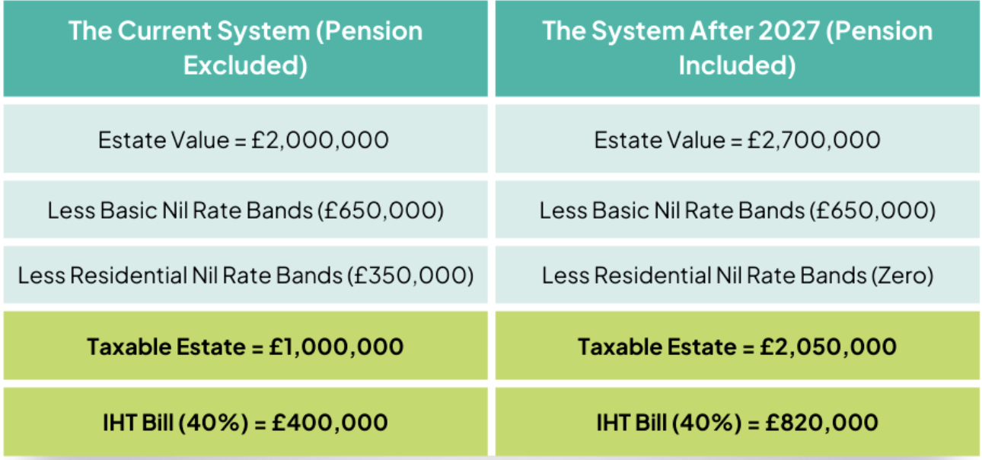
IHT liability + 105%
Pensions & IHT
Notes:
Presentation Notes – 5 minutes

Slide 14
Business Relief
New Legislation - £1m allowance
Up to 100% relief from IHT on qualifying assets
Applies to:
Certain shares in unlisted trading companies
Business assets held for at least 2 years
Recent changes: more HMRC scrutiny
Planning opportunities for family businesses and current BR qualifying holdings
Not transferable between spouses
Use it or lose it!

Slide 15
Planning Tips

Slide 16
Wills
Crucial to ensure matches your wishes
Carefully nominate beneficiaries
Integrate Trusts
Family Homes - a standard discretionary Trust will not be able to claim RNRB

Slide 17
Passing Wealth Directly
IHT erosion through generations
May not be chargeable on 1st transfer
Wealth exists in generation below
Trusts come into planning?
Discretionary
Absolute
IIP

Slide 18
Pensions
Drawdown Strategy
Should I take more than I need?
Can I gift it away now?
Should it fund a life assurance policy?
Tax free cash
Already inherited a drawdown pension?

Slide 19
Gifting Opportunities
Gifting out of Normal Expenditure
Regular gifting to children’s/grandchildren’s ISA/JISA/Pensions
Use drawdown of your own pension to fund the gifts
Ensure use of annual exemptions

Slide 20
Gifting out of Normal Expenditure
HMRC Conditions (all must be met)
Made as part of normal expenditure
The payments must be part of a regular pattern (e.g. monthly or annual premiums).
HMRC look for evidence of a consistent intention to make the payments.
Out of income, not capital
The premiums must be affordable from surplus income (salary, dividends, pensions, rental income).
You cannot rely on capital (e.g. selling shares each year).
No reduction in normal standard of living
After paying premiums, you must still maintain your usual lifestyle.
HMRC will consider bank statements and lifestyle evidence.

Slide 21
What is Income
HMRC don’t give a statutory definition of “income” — they say it takes its ordinary meaning, supported by case law and guidance in the Inheritance Tax Manual (IHTM14231–14241).
Generally, income is what would be declared on an income tax return:
Employment income – salary, bonus, commission, benefits in kind.
Pensions – state pension, annuity income, drawdown income (taxable withdrawals under ITEPA 2003).
Investment income – dividends, bank/building society interest, bond interest, gilt coupons.
Rental income – from property lettings
Trust income – distributions, income entitlements.
Partnership profits / sole trader income – taxable profits.
Regular overseas income – taxable in the UK.
Notes:
Presentation Notes – 5 minutes

Slide 22
Gifting to fund Pensions
You could use FAD to create income from which to gift
This can be paid to an ultimate beneficiaries pension!
For example:
£10,000 surplus taken you pay 40% tax so,
Net income and gift/payment to pension = £6,000
Gift £6,000 to child’s pension
Basic rate relief = £7,500 contribution
Higher rate taxpayer would claim another £1,500 from HMRC on tax return.

Slide 23
Insurance
Uses gifting out of normal expenditure exemption
Policies are written into Trust from the outset
Outside the scope of IHT if set up correctly
Use FAD for this?

Slide 24
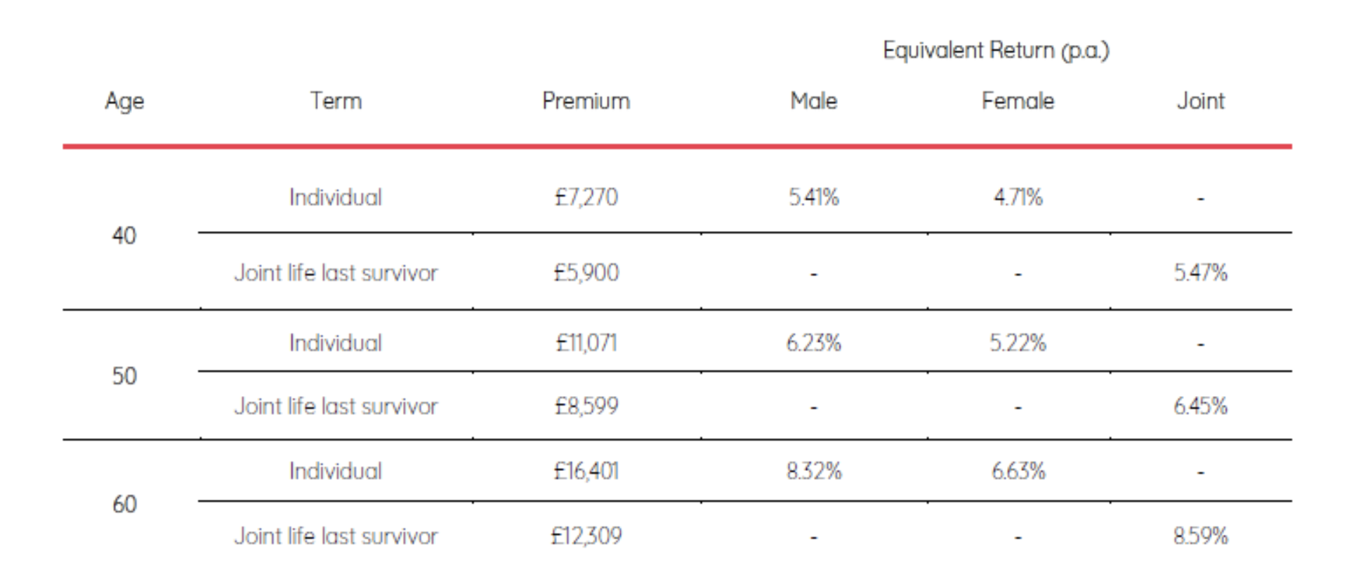
Investment Model: life expectancy of 81, guaranteed £1m WOL

Slide 25
Business Relief Review
£1 million limit per person, acting more like an allowance to use
AIM shares claim 50% relief (20% IHT liability)
Existing BR portfolio over £1m
Gifting away BR assets to Trust now
Current consultation: 7 year cycle for allowance, Trustees use 10 year anniversary

Slide 26
Other Trusts to Consider
Discounted Gift Trusts
Retained income for life of the Donor
Loan Trusts
Growth outside of the Estate
No immediate IHT considerations

Slide 27
Key Takeaways
Start planning early – use allowances annually
Trusts and insurance protect wealth effectively
Keep wealth outside the taxable estate where possible
Communicate and educate across generations

Slide 28


Scotch Corner
London Road
Sunningdale
Berkshire
SL5 0ER
ANY QUESTIONS?
Claire Calder
claire.calder@ascotwm.com
01344 851 250
FCA No.551744

