Slide 1


Portfolio Performance
Review & Outlook
Review of Q3 2025
This document is for informational purposes only and does not constitute investment advice.
The contents of this document are intended for the addressed recipient(s) only and not for others. All information contained within is to be considered confidential unless there is written confirmation otherwise.
Ascot Wealth Management Limited (trading as Cape Berkshire Asset Management), Scotch Corner, London Road, Sunningdale, Berkshire, SL5 0ER. Registered in England No. 11346295. Regulated by the FCA. Financial Services Register Number 551844.
© 2025 Ascot Wealth Management Ltd..

Slide 2


Today’s Speakers
Mark Insley
Managing Director
Sam Hallett
Portfolio Co-Manager

Slide 3
Important Notice
This presentation is for information purposes only and does not constitute any financial, legal or accounting advice.
Cape Berkshire Asset Management is a trading name of Ascot Wealth Management (FCA No. 551744).
Ascot Wealth Management is authorised and regulated by the Financial Conduct Authority.
These investments are not suitable for everyone.
Annual management charges apply.
Tax legislation could change in the future.
These investments could fall/rise more than mainstream investments however you could get back considerably less than you invested.

Slide 4
Table of Contents
Q3 2025 Portfolio Performance
Q3 Portfolio Activity
Reflection of a previous “Under the Hood”
Where to for 2025?
Portfolio Positioning
Q&A

Slide 5

Quarter 3 2025
Portfolio Performance
The webinar will begin soon.

Slide 6
Q2 2025 Performance
 | Performance | Int. Benchmark | ARC MPS Benchmark | Vs. Int Benchmark | Vs. ARC MPS Benchmark
P1 | 3.00 | 2.67 | 1.81 | +0.33 | +1.19
P2 | 4.27 | 3.93 | 2.82 | +0.34 | +1.45
P3 | 5.58 | 5.18 | 4.35 | +0.40 | +1.23
P4 | 7.00 | 6.49 | 5.89 | +0.51 | +1.11
P5 | 8.20 | 8.08 | 7.76 | +0.12 | +0.44
R1 | 2.67 | 2.67 | 1.81 | +0.00 | +0.06
R2 | 4.29 | 3.93 | 2.82 | +0.36 | +1.47
R3 | 5.61 | 5.18 | 4.35 | +0.43 | +1.26
R4 | 7.05 | 6.49 | 5.89 | +0.56 | +1.16
R5 | 8.68 | 8.08 | 7.76 | +0.60 | +0.92

Slide 7
YTD Performance Table to end of Q3
 | Performance | Int. Benchmark | ARC MPS Benchmark | Vs. Int Benchmark | Vs. ARC MPS Benchmark
P1 | 6.90 | 5.65 | 4.44 | +1.25 | +2.46
P2 | 8.45 | 7.01 | 5.58 | +1.44 | +2.87
P3 | 9.78 | 8.25 | 6.83 | +1.53 | +2.95
P4 | 11.49 | 9.55 | 7.89 | +1.94 | +3.60
P5 | 12.62 | 10.61 | 9.22 | +2.01 | +3.40
R1 | 5.19 | 5.65 | 4.44 | -0.46 | +0.75
R2 | 7.29 | 7.01 | 5.58 | +0.28 | +1.71
R3 | 8.61 | 8.25 | 6.83 | +0.36 | +1.78
R4 | 10.22 | 9.55 | 7.89 | +0.67 | +2.33
R5 | 11.61 | 10.61 | 9.22 | +1.00 | +2.39

Slide 8
Performance Table from P/R Inception (Jan 2024) to Date
 | Performance | Int. Benchmark | ARC MPS Benchmark | Vs. Int Benchmark | Vs. ARC MPS Benchmark
P1 | 15.34 | 11.31 | 8.81 | +4.03 | +6.53
P2 | 19.06 | 14.94 | 11.33 | +4.12 | +7.73
P3 | 22.96 | 18.87 | 14.66 | +4.09 | +8.30
P4 | 27.19 | 22.85 | 17.83 | +4.34 | +9.36
P5 | 29.66 | 27.48 | 21.52 | +2.18 | +8.14
R1 | 12.43 | 11.31 | 8.81 | +1.12 | +3.62
R2 | 17.41 | 14.94 | 11.33 | +2.47 | +6.08
R3 | 21.63 | 18.87 | 14.66 | +2.76 | +6.97
R4 | 26.43 | 22.85 | 17.83 | +3.58 | +8.60
R5 | 31.62 | 27.48 | 21.52 | +4.14 | +10.10

Slide 9
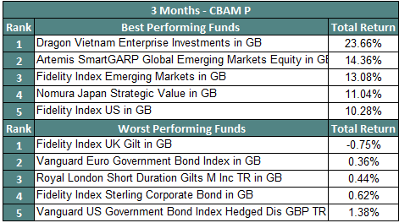
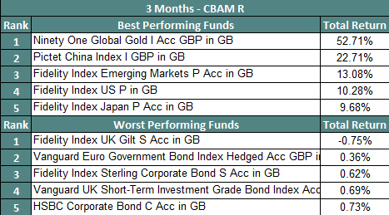
Top and Bottom performers – Q3 2025
On assumption all positions held since beginning of period

Slide 10
Q2 2025 Portfolio Activity
The webinar will begin soon.

Slide 11
Portfolio Trades – Q3 2025
DATE | Fund Name | 1 | 2 | 3 | 4 | 5
5/9/2025 | Royal London Short Tm Mny Mkt Y Acc | 4.22% | 3.51% | 3.15% | 2.91% | 1.53%
5/9/2025 | Vontobel Emrg Mkt Blnd AQHN (h) IGBP | 1.77% | 1.57% | 1.35% | 0.00% | 0.00%
5/9/2025 | Pimco GIS EmMk Bd I Hgd Inc GBP | 0.58% | 0.52% | 0.45% | 0.00% | 0.00%
5/9/2025 | L&G Em Gov Bd (US$) Index I Acc | -1.17% | -1.04% | -0.90% | 0.00% | 0.00%
5/9/2025 | M&G Emerging Mkts Bd I Acc GBP | -1.18% | -1.05% | -0.90% | 0.00% | 0.00%
7/8/2025 | Royal London Short Duration Gilts | 2.00% | 2.00% | 2.00% | 2.00% | 2.00%
5/8/2025 | Royal London Diversified Asset Backed Securities | -5.89% | -5.56% | -4.88% | -4.42% | -2.00%
31/7/2025 | Fidelity US Index | 0.00% | 0.00% | 0.00% | 0.00% | 1.77%
31/7/2025 | Fidelity S&P 500 H | 0.00% | 0.00% | 0.00% | 0.00% | 0.37%
30/7/2025 | Aretmis Smart GARP European Equity | -1.18% | -1.03% | -0.85% | -0.86% | -0.80%
30/7/2025 | HSBC European Index C Acc | -0.44% | -0.42% | -0.38% | -0.30% | -0.33%
30/7/2025 | Nomura Japan Strategic Value | -0.14% | 0.00% | -0.38% | -0.58% | -0.42%
30/7/2025 | Fidelity Index Japan | -0.07% | 0.00% | -0.16% | -0.25% | -0.21%
30/7/2025 | JPM US Equity Income | 0.00% | 0.00% | 0.00% | 0.00% | -3.41%

Slide 12
Portfolio Trades – Q3 2025
DATE | Fund Name | 1 | 2 | 3 | 4 | 5
29/9/2025 | Fidelity S&P 500 H | -0.25% | -0.30% | -0.20% | 0.00% | 0.00%
29/9/2025 | Fidelity Index US | -1.00% | -1.20% | -0.80% | 0.00% | 0.00%
29/9/2025 | abrdn Global Infrastructure Equity Tracker | 1.50% | 1.25% | 1.00% | 0.75% | 0.50%
29/9/2025 | Lazard Global Listed Infrastructure Equity | 1.50% | 1.25% | 1.00% | 0.75% | 0.50%
29/9/2025 | iShare TIP 0-5 years ETF | 1.00% | 1.00% | 1.00% | 1.00% | 0.50%
29/9/2025 | Royal London Short Duration Gilts | 1.00% | 0.75% | 0.00% | 0.00% | 0.00%
29/9/2025 | T Rowe Price US Smaller Companies USD H | 0.35% | 0.50% | 0.40% | 0.30% | 0.30%
29/9/2025 | T Rowe Price US Smaller Companies | 1.40% | 2.00% | 1.60% | 1.20% | 1.20%
29/9/2025 | Vietnam Enterprise Investment Ltd | 1.00% | 1.00% | 1.00% | 1.00% | 1.00%
26/9/2025 | Fidelity Index UK Gilt | 0.00% | 0.00% | -1.43% | -1.79% | -0.57%
26/9/2025 | L&G Global Infrastructure Index | -2.00% | -3.00% | -0.75% | -2.00% | -1.00%
26/9/2025 | Royal London Short Duration Gilts | 0.00% | 0.00% | 0.00% | 0.00% | -1.63%
26/9/2025 | Royal London Short Term Money Market | -4.22% | -3.51% | -3.15% | -2.91% | -1.53%
26/9/2025 | Vanguard US Government Bond | -2.00% | -2.00% | -2.00% | -2.00% | -0.49%
26/9/2025 | Vanguard UK Inflation Linked Gilt Index | -2.12% | -1.51% | -1.00% | 0.00% | 0.00%

Slide 13
Conference Season Review
The webinar will begin soon.

Slide 14
US Economy
Weakening Jobs Reports
But Corporate Investment High
Change in Federal Reserve for 2026
Tax cuts and spending changes kick in Jan 2026
Expected restrengthening in 2026
US Midterms Q4 2026
Tariffs yet to feed through in to meaningful CPI impact

Slide 15
AI Story
Continuing very strong growth
Incredible Capital Expenditure fuelling Growth
Both at AI Ltd level as well as Users.
Seen in line with 1997 narrative at present.
Circular Financing occurring: End of ability for the Capital Expenditure to be able to be financed by Ltds own cash?

Slide 16
What is in store for the remainder of 2025?
The webinar will begin soon.

Slide 17
What’s in store?
 | Unfavourable | Base Case | Favourable
US Inflation (Degree of Caution) | Tariff wars end up going back to their tit-for-tat stage but more global in nature. Tariff wars could easily push US CPI to 5%. | Stagflation is becoming more of a concern. Current tariff measures add around 1% to CPI by end of 2025. | Concerns over GDP resulting in much reduced energy prices. Tariff wars are “resolved”
US GDP | US Retail Sales decrease strongly. This has been helping power US GDP for last few years. Mild Recession. US Subprime borrower metrics already showing warning signs. | Slowing Real GDP to low 1% range. Consumer Squeeze restart due to tariff wars. Increased construction due to tariff wars. | Tariff wars mean much greater “reshoring”, resulting in greater employment Concerns over GDP
UK GDP | Tariff war knock-on effects result in reduced consumer confidence and exports. Mild recession. | “Steady as she goes”. Real Earnings Growth positive. Real GDP Growth around 1.0% | Increased Consumer Spending. Increased productivity growth from AI in services sector. GDP surprise to maybe 2.0%. UK-US Trade agreement small upside surprise.
UK Inflation | Tariff “Wars” move beyond just US-centric. Services inflation proves very “sticky”. CPI in mid to high 3% region. | Energy has resulted in favourable conditions. A degree of China trade diversion resulting in cheaper goods to UK. Base effects from last year will come out though, expect inflation to be in the low 3% range by end of year. | Large China trade diversion resulting in cheaper goods to UK. World GDP Growth scare results in cheaper energy. Services inflation moves downwards sharply (unlikely). CPI in low 2% range.
US Treasuries | Higher than expected tax cuts, tariff pause is literally only a pause would result in US 10Yr moving in to the 5.5% region. | Move for 10 Year to move to 5% (Would be around a 5% capital loss but the income yield will reduce that loss somewhat). | Recessionary Case would move the US 10Yr in to the 3% range
UK Gilts | Further spending pledges made by UK Government without corresponding spending cuts. Tax rises are not enough to prevent further yield rises. | Currently Cheap vs Treasury. Tied heavily to what happens to US Treasury. See the “unfavourable” outlook more likely than “favourable”. | Spending cut agenda picks up pace. No further spending pledges made. Tax receipts hold steady.
US Equity | Earnings Projections revised downwards towards 0 growth or worse | Tax Cuts and Deregulation Narrative to kick in | Full recovery to pre-April Valuation Multiples
Infrastructure | Below expected inflation outlook and higher US Treasury Yields. | Increasing US Inflation resulting in increased earnings. 10Yr US Treasury to move up 0.50% | US Recessionary case with high inflation would result in higher earnings but reduced Treasury Yield. Both Net Positive for Infrastructure.

Slide 18
Portfolio Positioning
The webinar will begin soon.

Slide 19
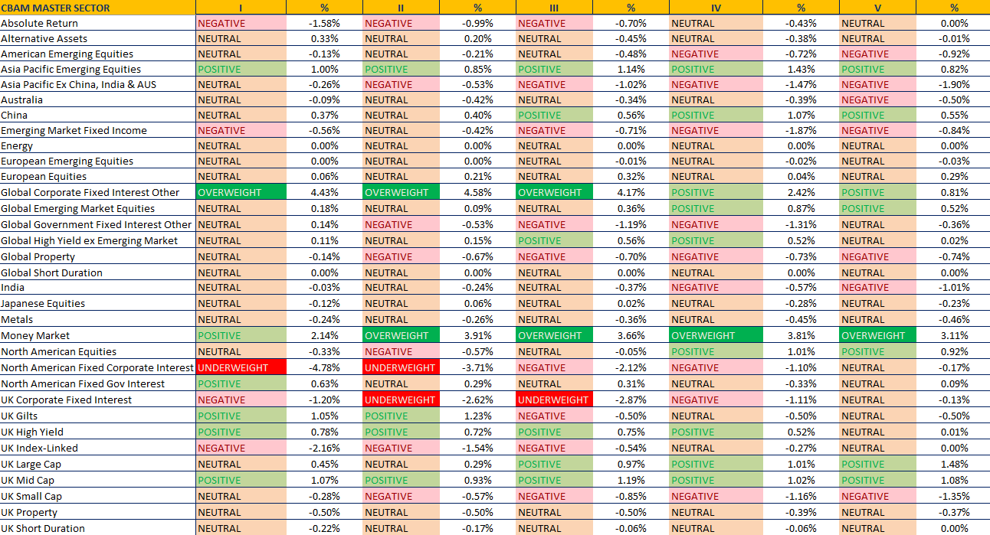

Slide 20

This document is for informational purposes only and does not constitute investment advice.
The contents of this document are intended for the addressed recipient(s) only and not for others. All information contained within is to be considered confidential unless there is written confirmation otherwise.
Ascot Wealth Management Limited (trading as Cape Berkshire Asset Management), Scotch Corner, London Road, Sunningdale, Berkshire, SL5 0ER. Registered in England No. 11346295. Regulated by the FCA. Financial Services Register Number 551844.
© 2025 Ascot Wealth Management Ltd..

